Slide 1
Airplane Flight Controls

Slide 2
The three primary flight controls control the airplane’s attitude
Ailerons
Elevator
Rudder
Notes:
“System approach” to aviation safety
Methods instructors can use to teach students to use practical risk management tools, discuss how to evaluate student decision-making

Slide 3
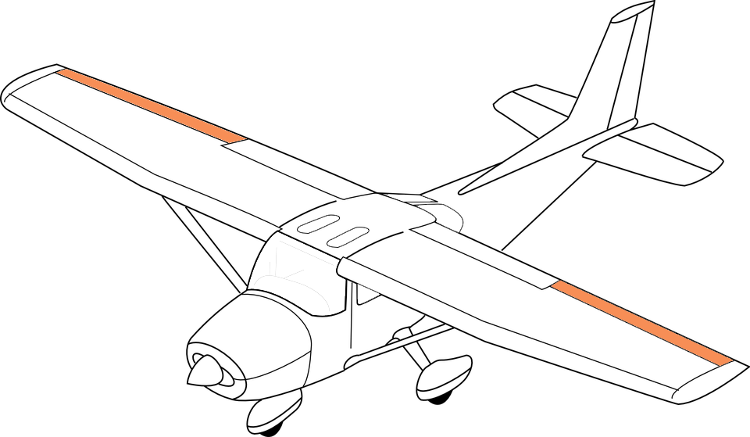
Ailerons
Movement
Turning
Adverse yaw
Types
Elevator
Rudder
Control roll about longitudinal axis
Interconnected—operate simultaneously in opposite directions

Slide 4
Ailerons
Movement
Turning
Adverse yaw
Types
Elevator
Rudder
Yoke to the right
Right aileron deflects upward (left downward)
Downward deflection increases camber and lift (upward deflection decreases lift)
Increased lift on left wing, decreased on right → turn to the right

Slide 5
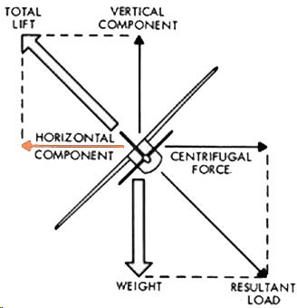
Ailerons
Movement
Turning
Adverse yaw
Types
Elevator
Rudder
Horizontal component of lift
Counteracts centrifugal force

Slide 6
Ailerons
Movement
Turning
Adverse yaw
Types
Elevator
Rudder
More lift = more drag
Added drag yaws nose to the direction of the raised wing
Use rudder to counteract
More needed at low airspeed/high angle of attack and with large aileron deflections

Slide 7
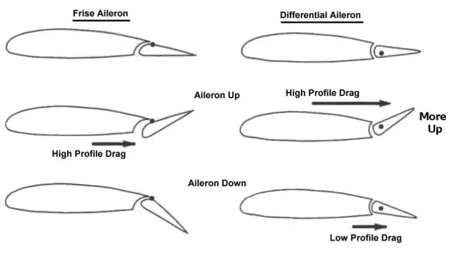
Ailerons
Movement
Turning
Adverse yaw
Types
Elevator
Rudder
Differential ailerons
One aileron raise more than other lowered
Increased drag on descending wing
Frise-type ailerons
Raised aileron pivots on offset hinge
Leading edge of aileron into airflow creates drag to equalize lowered aileron drag
More effective at high AOA

Slide 8
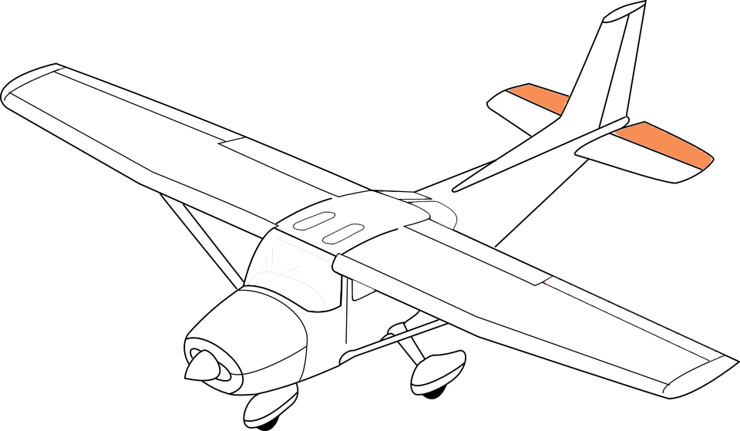
Ailerons
Elevator
Movement
Types
Rudder
Controls pitch about lateral axis

Slide 9
Ailerons
Elevator
Movement
Types
Rudder
Pull yoke
Elevator (trailing edge) deflects upward
Upward deflection decreases camber and lift → downward aerodynamic force
Tail moves down—nose pitches up

Slide 10
Ailerons
Elevator
Movement
Types
Rudder
T-tail
Elevator above downwash effects
Slow airspeed—elevator less effective without downwash to assist in raising the nose
Stabilator
Combines horizontal stabilizer and elevator
Anti-servo tabs
On trailing edge
Decrease sensitivity
Move the same direction as the trailing edge
Provide resistance so that pilot does not overcontrol the airplane

Slide 11
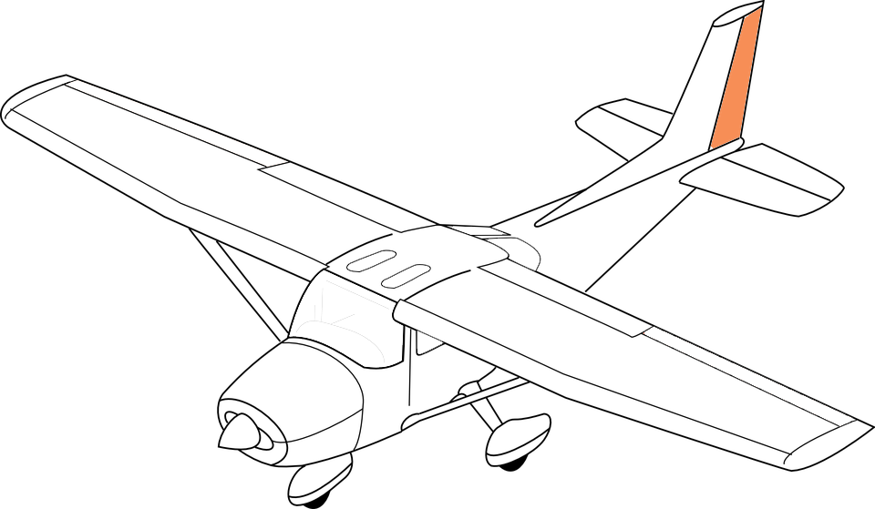
Ailerons
Elevator
Rudder
Movement
Controls yaw around vertical axis
Operated though cables

Slide 12
Ailerons
Elevator
Rudder
Movement
Push left pedal
Rudder moves to the left, altering airflow around vertical stabilizer
Creates sideward force—moves the tail to the right, yaws the nose to the left
Effectiveness increases with speed and slipstream
Purpose
Counteract adverse yaw
Provide directional control and coordination

