Slide 1
Operation of Flight Systems
Static System Instruments
Gyroscopic Instruments
Turn Indicators
Compass

Slide 2
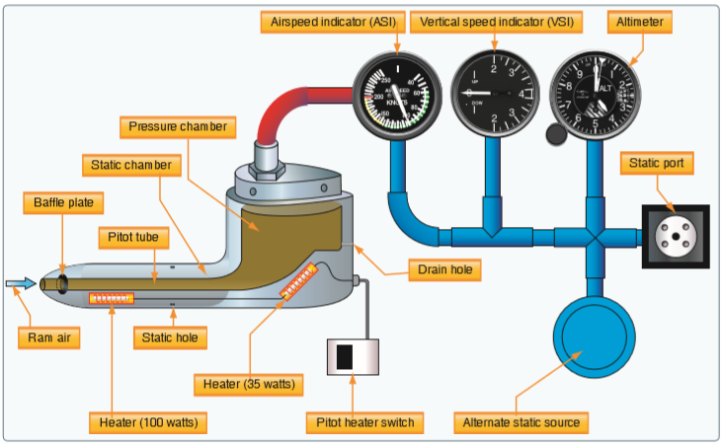
Static system
Airspeed indicator
Altimeter
Vertical speed indicator
Errors
Gyroscopic instruments
Magnetic compass
Three instruments operate on static system
Airspeed indicator
Altimeter
Vertical speed indicator

Slide 3
Static system
Airspeed indicator
Altimeter
Vertical speed indicator
Errors
Gyroscopic instruments
Magnetic compass
Pitot tube—mounted on left wing
Provides ram air pressure
Heated through heating element (pitot heat rocker arm switch)
Static ports—on sides of fuselage (x2)
Provide static air pressure
Alternate static pressure source beneath panel; activated by push/pull knob
Lower pressure in cabin—momentary rise in airspeed, altitude, and vertical speed

Slide 4
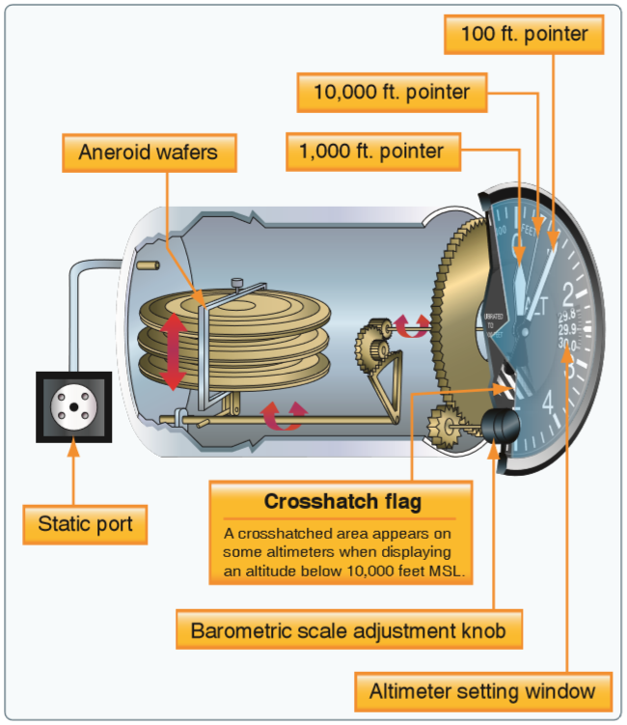
Static system
Airspeed indicator
Altimeter
Vertical speed indicator
Errors
Gyroscopic instruments
Magnetic compass
Measures/indicates difference between pitot (impact/dynamic) pressure and static pressure.
Static pressure to airspeed case; pitot pressure to diaphragm.

Slide 5
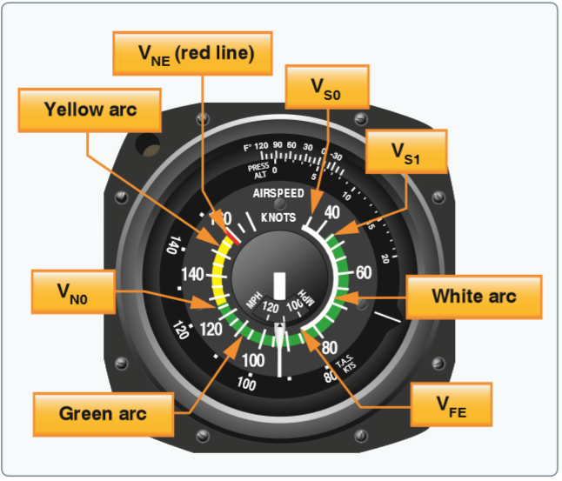
Static system
Airspeed indicator
Altimeter
Vertical speed indicator
Errors
Gyroscopic instruments
Magnetic compass
Markings
White arc (flap operating range)
Green arc (normal operating range)
Yellow arc (caution range)
Red line (never exceed speed)

Slide 6
Static system
Airspeed indicator
Altimeter
Vertical speed indicator
Errors
Gyroscopic instruments
Magnetic compass
Airspeeds
Indicated airspeed (IAS)
Calibrated airspeed (CAS)
Equivalent airspeed (EAS)
True airspeed (TAS)
Groundspeed (GS)

Slide 7
Static system
Airspeed indicator
Altimeter
Vertical speed indicator
Errors
Gyroscopic instruments
Magnetic compass
Measures height of aircraft above a given pressure level. (Kolesman window)
Series of aneroid wafers expand (when climbing) and contract (when descending) in response to the changing static pressure.

Slide 8
Static system
Airspeed indicator
Altimeter
Vertical speed indicator
Errors
Gyroscopic instruments
Magnetic compass
Altitudes
Indicated altitude
True altitude (MSL)
Absolute altitude (AGL)
Pressure altitude
Density altitude
Errors
“High to low, look out below; low to high, clear the sky.”
As the airplane enters an area of lower pressure, the altimeter will read lower than actual if setting not adjusted.

Slide 9
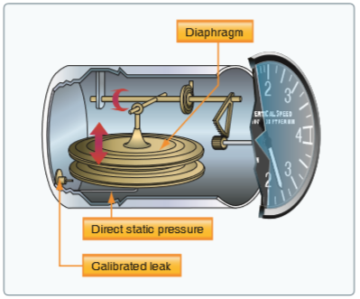
Static system
Airspeed indicator
Altimeter
Vertical speed indicator
Errors
Gyroscopic instruments
Magnetic compass
Static air enters chamber with calibrated leak—moves diaphragm and linkage.
Instantaneous indication of increase/decrease in rate
Rate of change in altitude once stabilized (6-9 seconds)

Slide 10
Static system
Airspeed indicator
Altimeter
Vertical speed indicator
Errors
Gyroscopic instruments
Magnetic compass
Pitot tube blocked, drain hole open
Airspeed indicates zero

Slide 11
Static system
Airspeed indicator
Altimeter
Vertical speed indicator
Errors
Gyroscopic instruments
Magnetic compass
Pitot tube blocked, drain hole blocked
Airspeed indicator acts like an altimeter

Slide 12
Static system
Airspeed indicator
Altimeter
Vertical speed indicator
Errors
Gyroscopic instruments
Magnetic compass
Static port blocked, drain hole blocked
VSI and altimeter freeze
Airspeed will read lower above blockage altitude; higher below blockage altitude

Slide 13
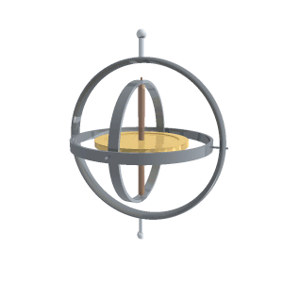
Static system
Gyroscopic instruments
Principles
Power
Turn indicators
Attitude indicator
Heading indicator
Magnetic compass
Rigidity in space
Gyroscope remains in a fixed position in the plane in which it is spinning

Slide 14
Static system
Gyroscopic instruments
Principles
Power
Turn indicators
Attitude indicator
Heading indicator
Magnetic compass
Rigidity in space
Gyroscope remains in a fixed position in the plane in which it is spinning
Precession
Tilting/turning of a gyroscope in response to a deflective force
Occurs at a point 90° later in the direction of rotation
Allows the gyroscope to determine rate of turn

Slide 15
Static system
Gyroscopic instruments
Principles
Power
Turn indicators
Attitude indicator
Heading indicator
Magnetic compass
Electric
Pressure
Vacuum

Slide 16
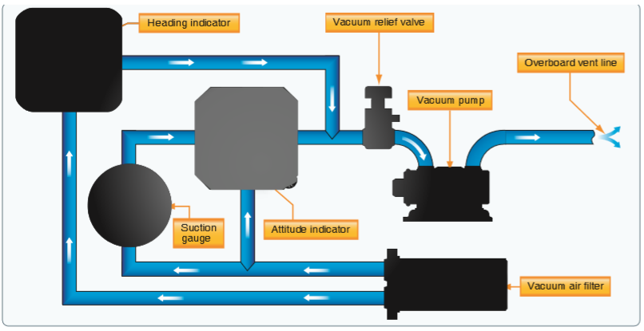
Static system
Gyroscopic instruments
Principles
Power
Turn indicators
Attitude indicator
Heading indicator
Magnetic compass
Vacuum system draws stream of air against the rotor vanes
Air stream spins the gyroscope rotor at high speeds

Slide 17
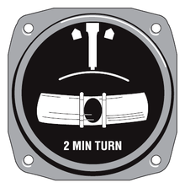
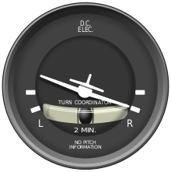
Static system
Gyroscopic instruments
Principles
Power
Turn indicators
Attitude indicator
Heading indicator
Magnetic compass
Turn-and-slip indicator
Rate of turn (degrees per second)
Coordination
Turn coordinator
Rate of turn
Rate of roll
Coordination
Inclinometer
Depicts yaw
Gravity forces ball to rest in lowest part of tube

Slide 18
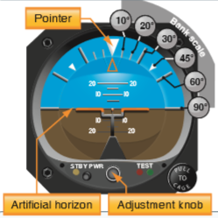
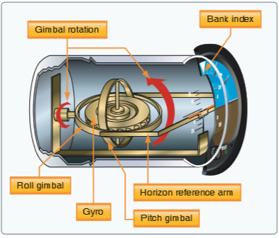
Static system
Gyroscopic instruments
Principles
Power
Turn indicators
Attitude indicator
Heading indicator
Magnetic compass
Limitations
Maximum bank 100°
Maximum pitch 60°
Instantaneous indication of small changes
Adjustment knob

Slide 19
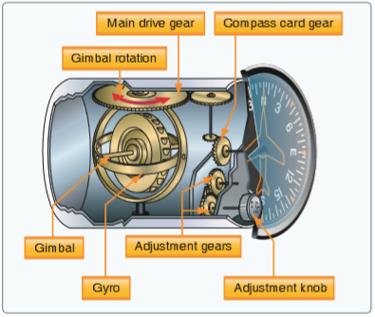
Static system
Gyroscopic instruments
Principles
Power
Turn indicators
Attitude indicator
Heading indicator
Magnetic compass
Drifts from set position
Amount of drift depends on instrument condition

Slide 20
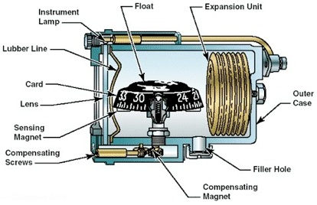
Static system
Gyroscopic instruments
Magnetic compass
Errors
Vertical card
Two small magnets attached to metal float—align with Earth’s magnetic field
Hardened steel pivot in float’s center rides inside spring-loaded hard glass jewel cup.
Allows float freedom
Float buoyancy takes weight off pivot
Fluid dampens float oscillation
Flexible diaphragm seal to allow for temperature changes
Compensator assembly
Variation cardholder

Slide 21
Static system
Gyroscopic instruments
Magnetic compass
Errors
Vertical card
Variation
Deviation
Magnetic dip error
Oscillation error

Slide 22
Static system
Gyroscopic instruments
Magnetic compass
Errors
Vertical card
Variation
Also known as declination
Difference between true and magnetic North
Deviation
Magnetic dip error
Oscillation error

Slide 23
Static system
Gyroscopic instruments
Magnetic compass
Errors
Vertical card
Variation
Deviation
Local magnetic fields cause compass error
Differ for each heading
Not affected by geographic location
Swinging the compass/cardholder
Magnetic dip error
Oscillation error

Slide 24
Static system
Gyroscopic instruments
Magnetic compass
Errors
Vertical card
Variation
Deviation
Magnetic dip error
Magnets align with magnetic flux lines—near the poles, they dip (tilt) the float
Dip-compensating weight that dampens the effect of dip causes other errors
Northerly turning error
Acceleration error
Oscillation error

Slide 25
Static system
Gyroscopic instruments
Magnetic compass
Errors
Vertical card
Variation
Deviation
Magnetic dip error
Northerly turning error (UNOS)
Vertical component of Earth’s magnetic field pulls north-seeking end of magnet toward the Earth
Turning from the North to the East/West—initially indicates a turn in the opposite direction
Turning from the South—turns in the same direction at a faster rate
Acceleration error
Oscillation error

Slide 26
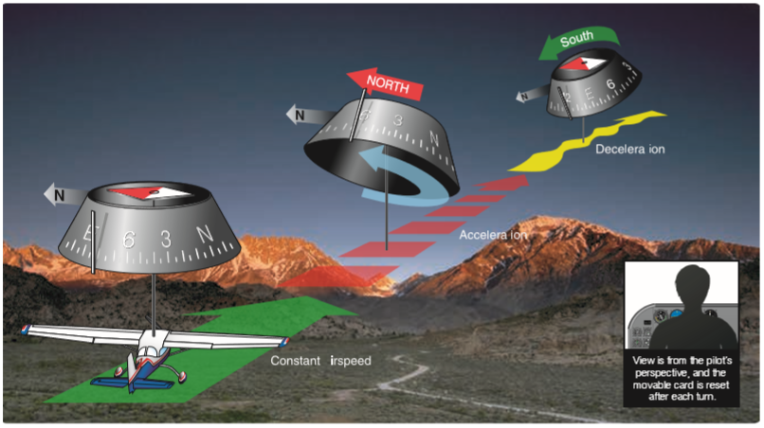
Static system
Gyroscopic instruments
Magnetic compass
Errors
Vertical card
Variation
Deviation
Magnetic dip error
Northerly turning error
Acceleration error (ANDS)
Dip correction weight causes the south-seeking end of the magnet to be heavier
East/West heading—float is level
Accelerating—compass indicates a turn to the North
Decelerating—compass indicates a turn to the South
Oscillation error

Slide 27
Static system
Gyroscopic instruments
Magnetic compass
Errors
Vertical card
Variation
Deviation
Magnetic dip error
Oscillation error
Combination of all errors
Compass card swings back and forth around heading
Use average indication between swings

Slide 28
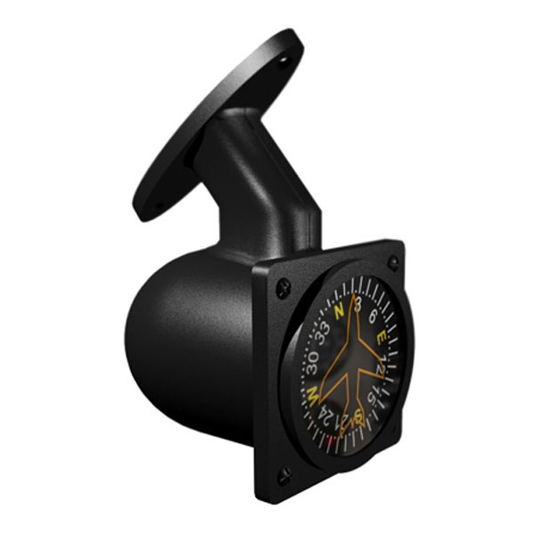
Static system
Gyroscopic instruments
Magnetic compass
Errors
Vertical card
Easier to read and use
Eliminates some of the errors
When turning from a heading of North, compass lags
When turning from a heading of South, compass leads turn

